Slide 1
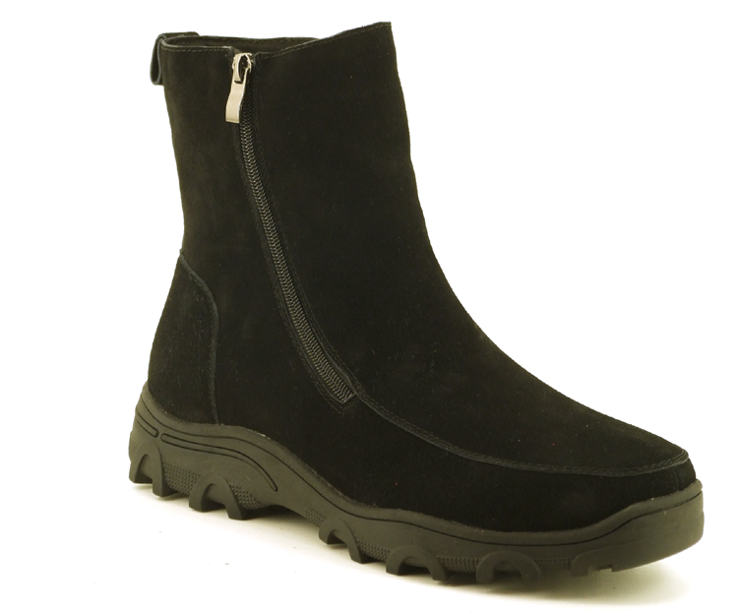
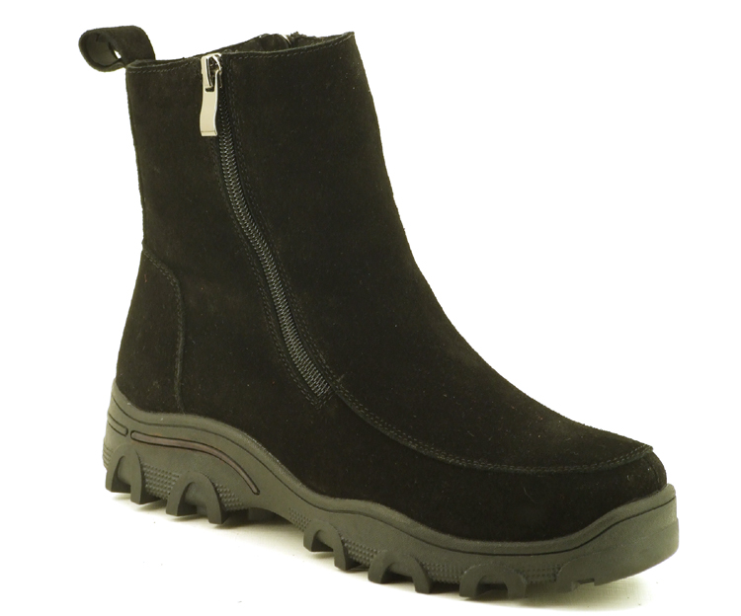
UTFÄLLBARA BRODDAR
LEAMOUTH
05562518 BRODD DAM
05562519 BRODD HERR

Slide 2
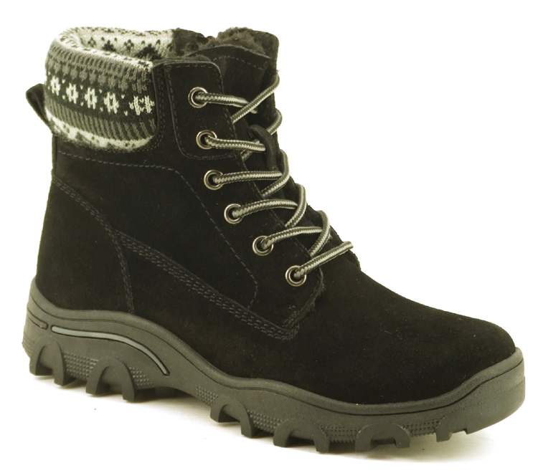
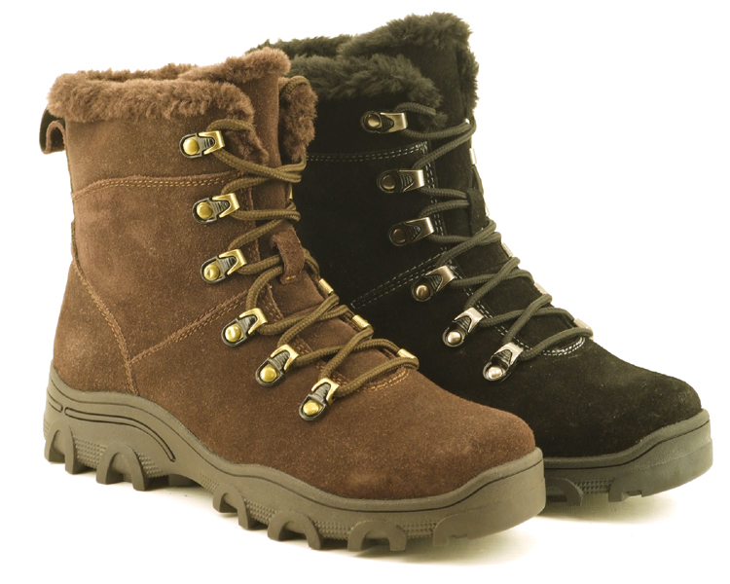
UTFÄLLBARA BRODDAR
05562310
BEND BRODD
05562520
OLD FORD BRODD

Slide 3
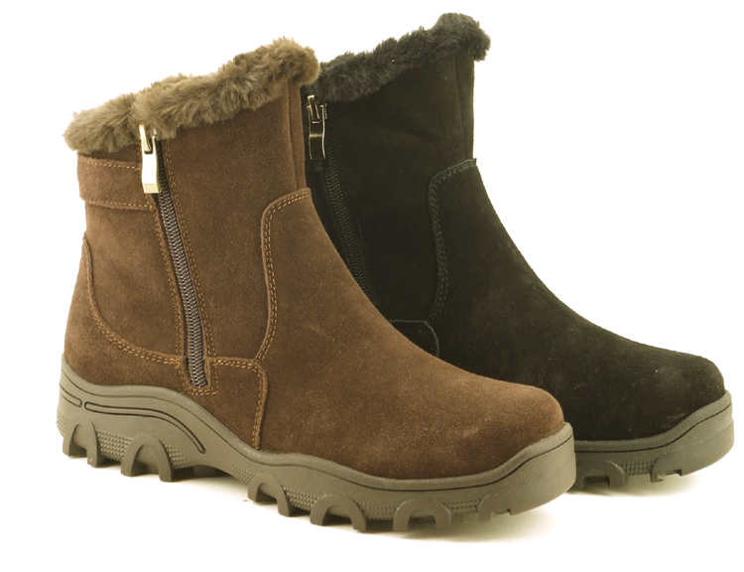
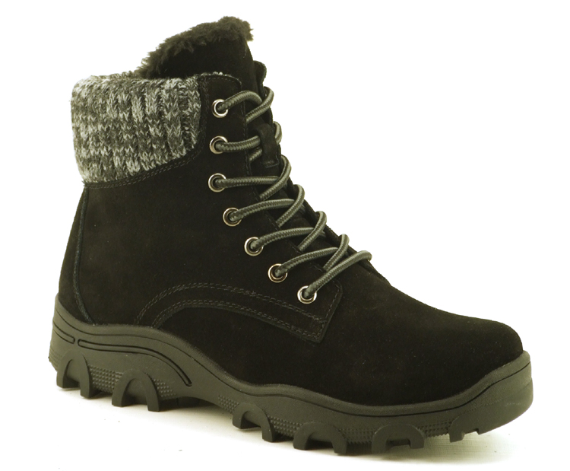
UTFÄLLBARA BRODDAR
05562521
RAMONA BRODD
05562522
PALMERS BRODD

Slide 4
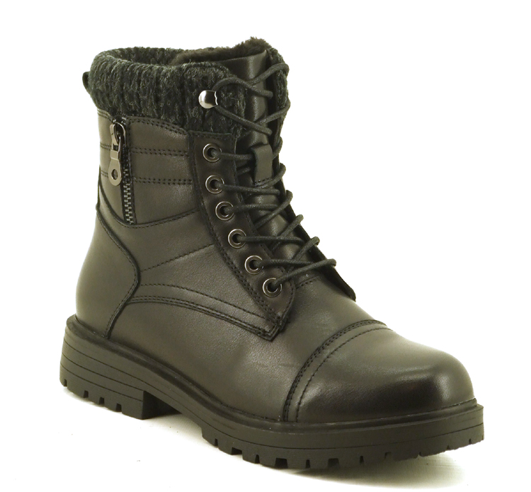
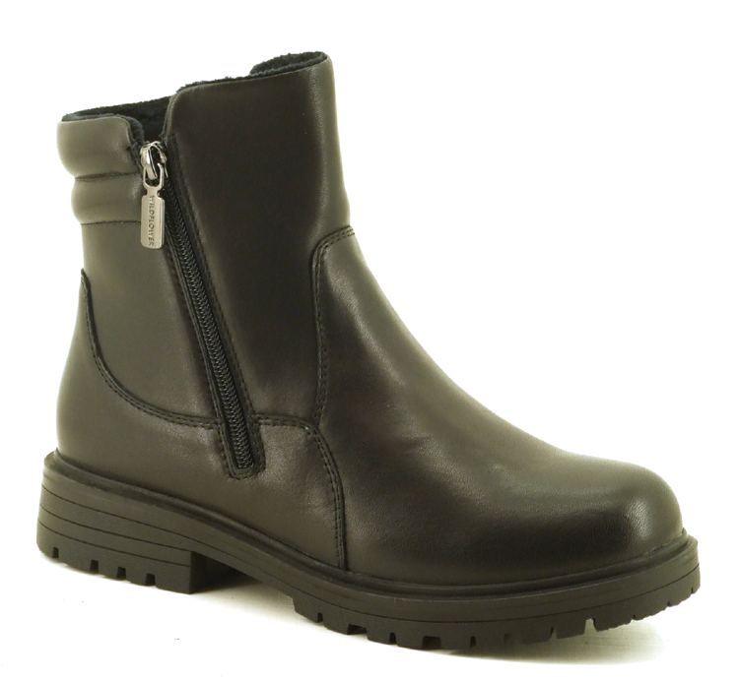
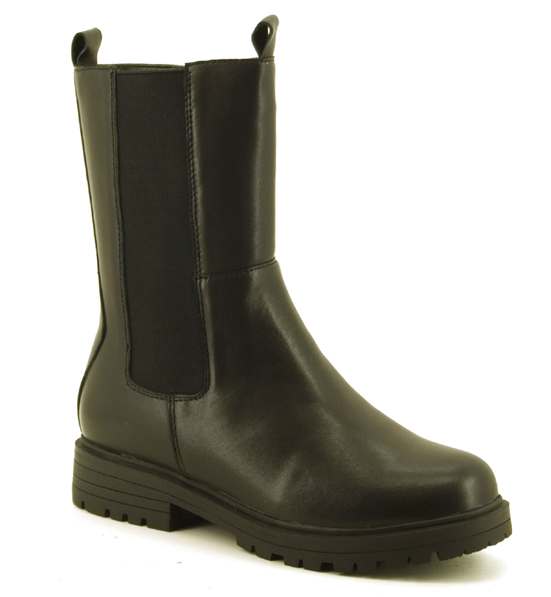
UTFÄLLBARA BRODDAR
08562529
SUNBERRY BRODD
08562530
BENEDETTA BRODD
08562531
ASIA BRODD

Slide 5
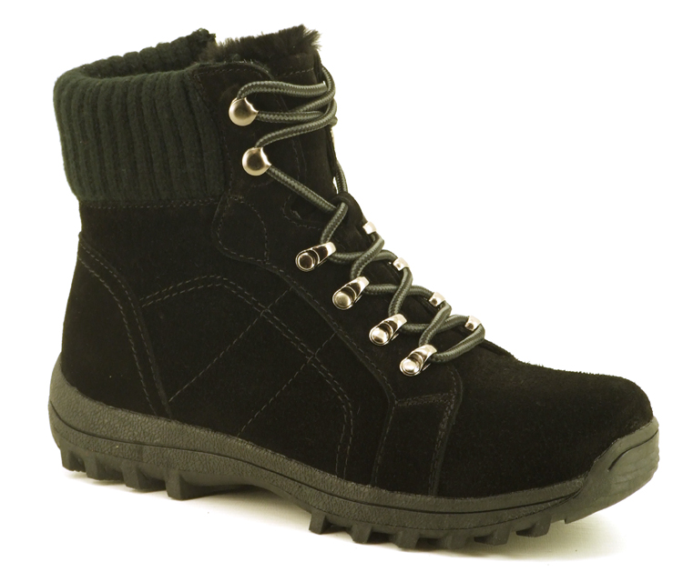
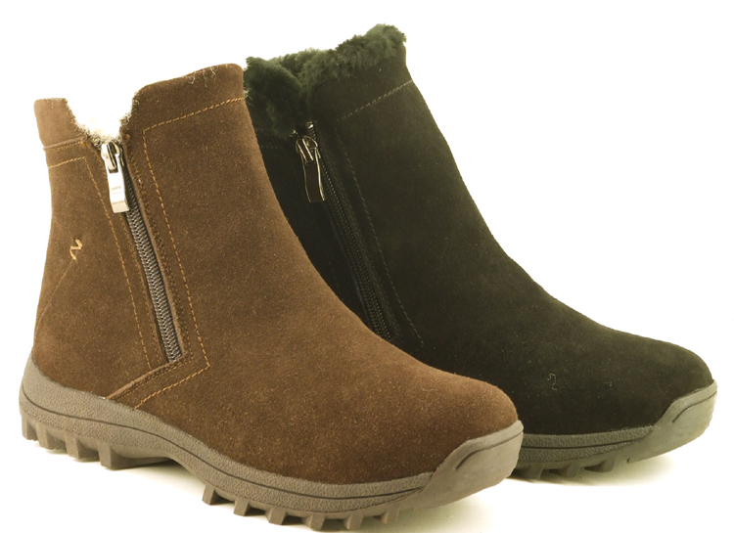
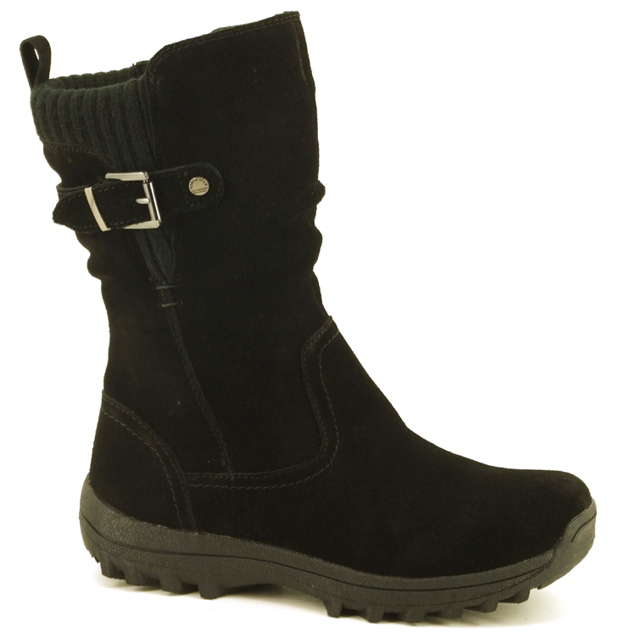
05562527
LISSON
05562528
HOLLOWAY
05562529
MERTON

